Slide 1
Micro Credit Defaulter project
Submitted By :
Mini Sharma

Slide 2
Problem Statement

Slide 3
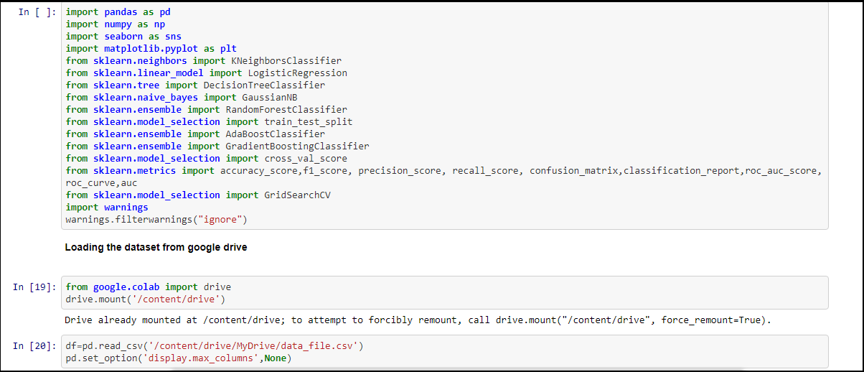
Importing necessary libraries and loading data set

Slide 4
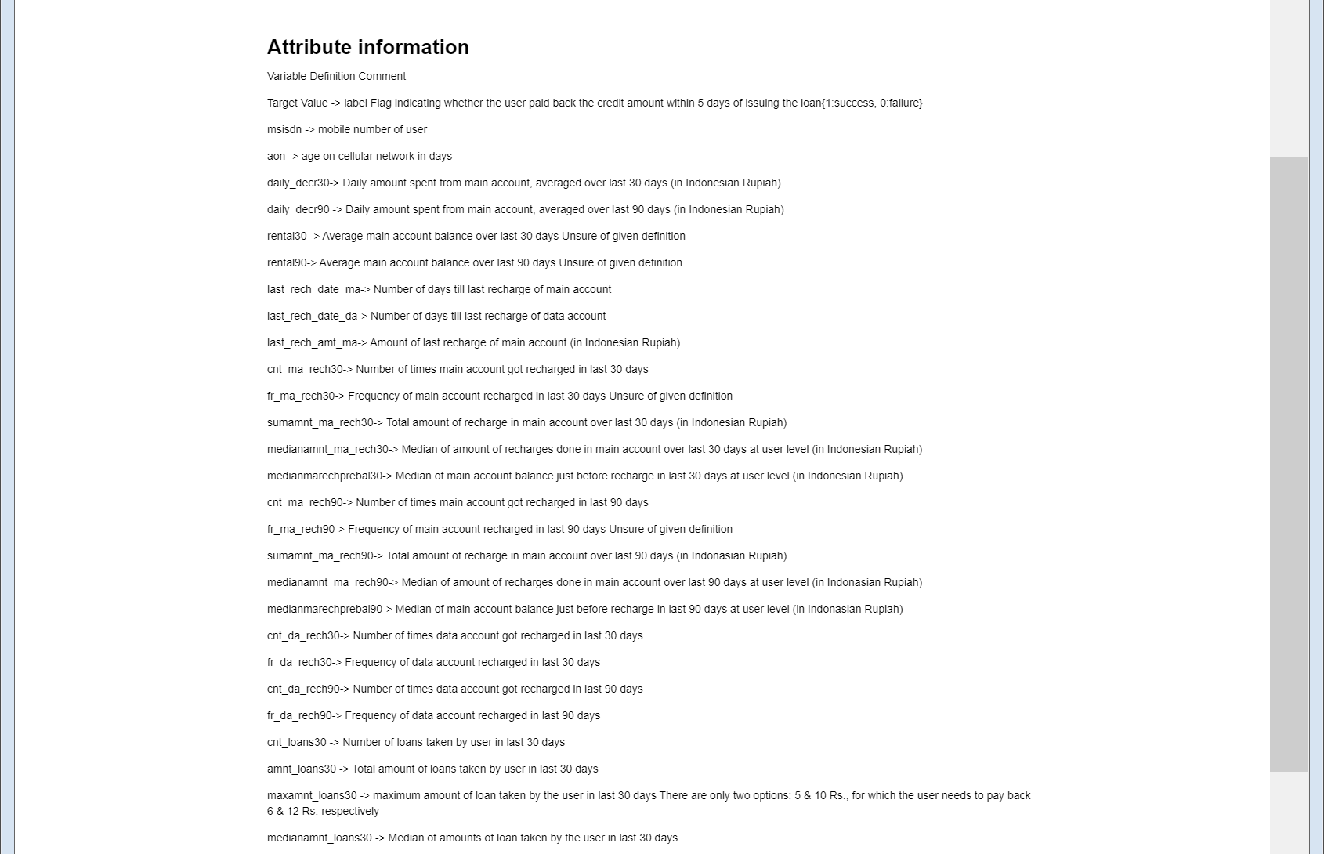
Lets see attribute information

Slide 5
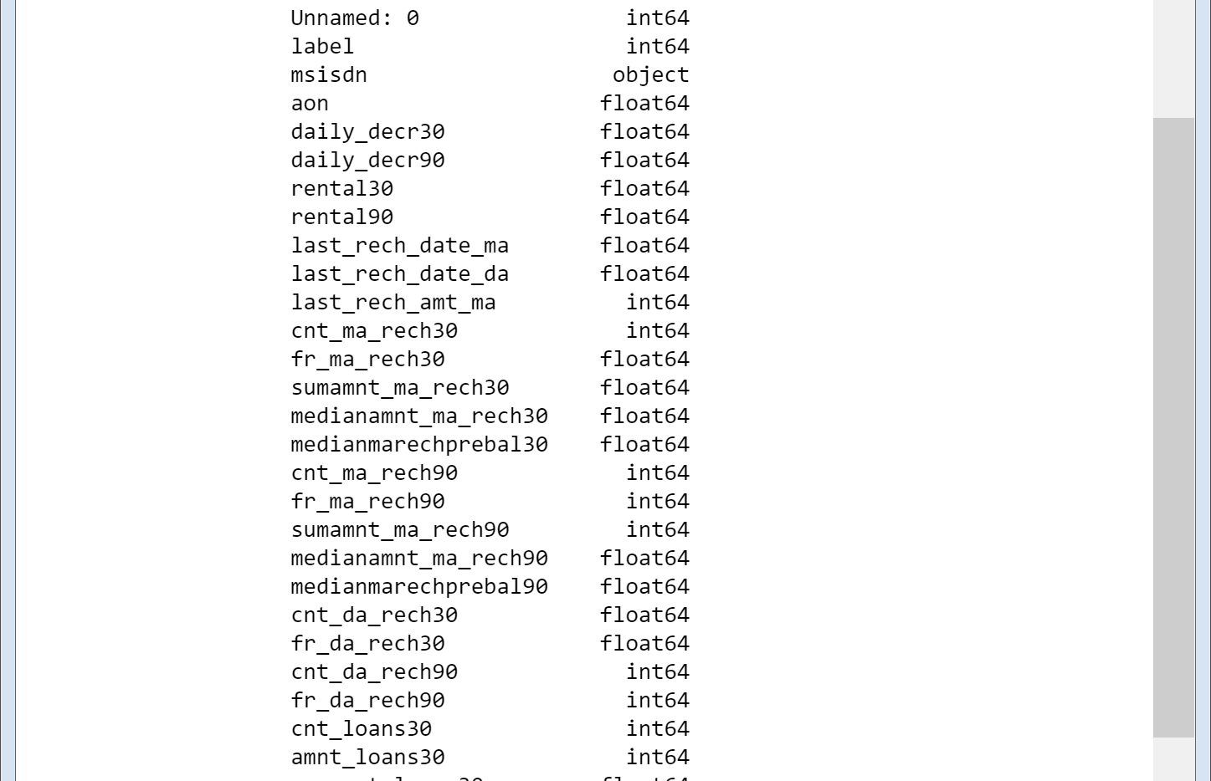
Lets see shape of dataset and check their datatypes

Slide 6
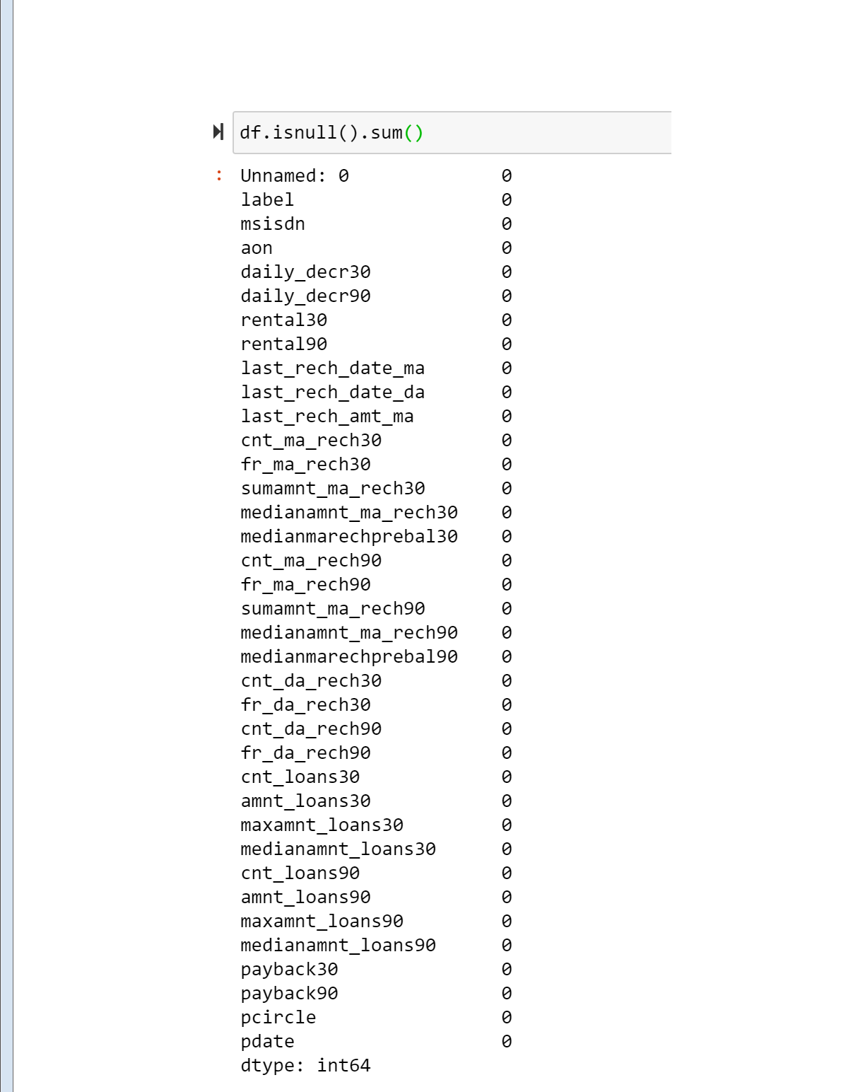
Checking Null Values in the Dataset

Slide 7
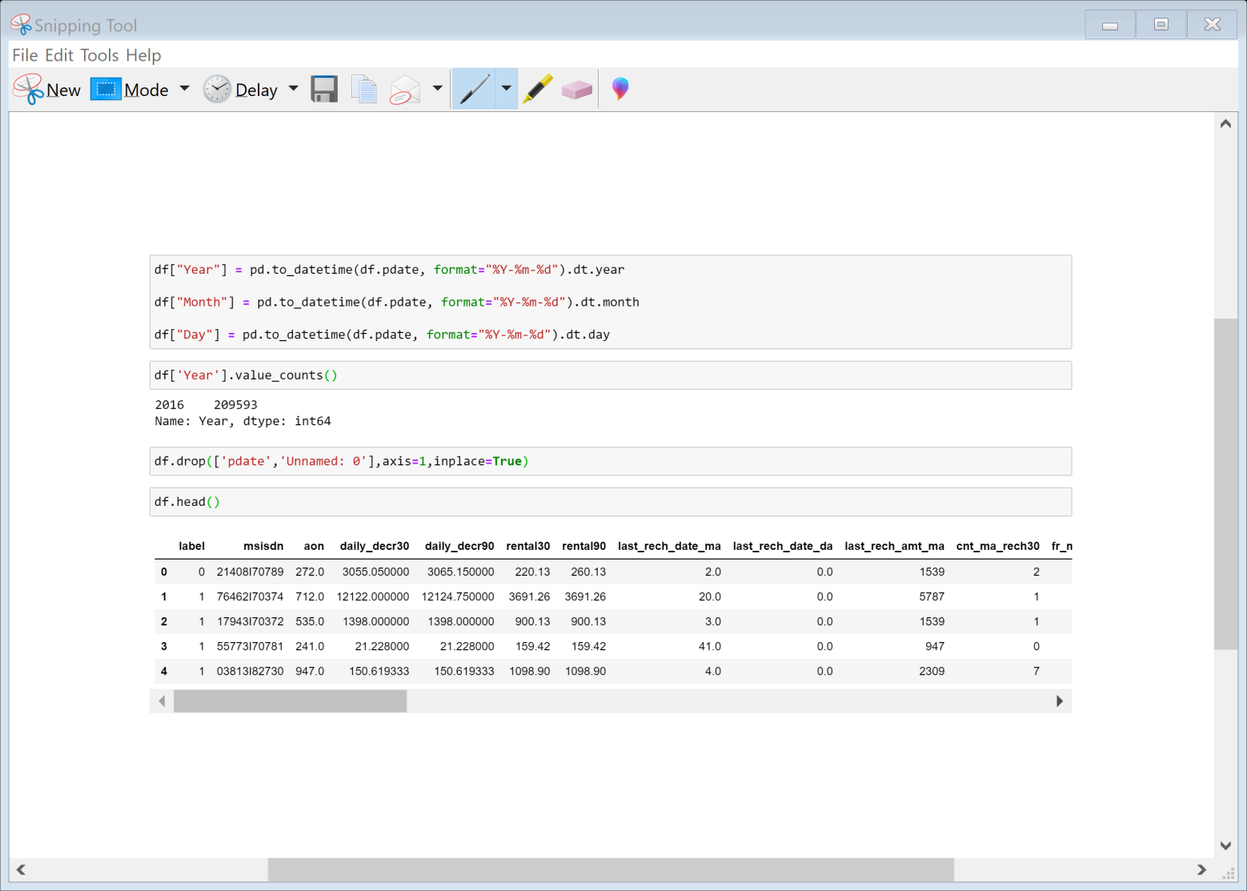
Lets do some Data Pre-processing
➢ Data set contains pdate in format of year ,month and date. We will split the pdate column for further analysis.
➢ After checking the unique values of each column we can see that year count is only one soo we will drop pdate , year and unnamed as it is of no use.

Slide 8
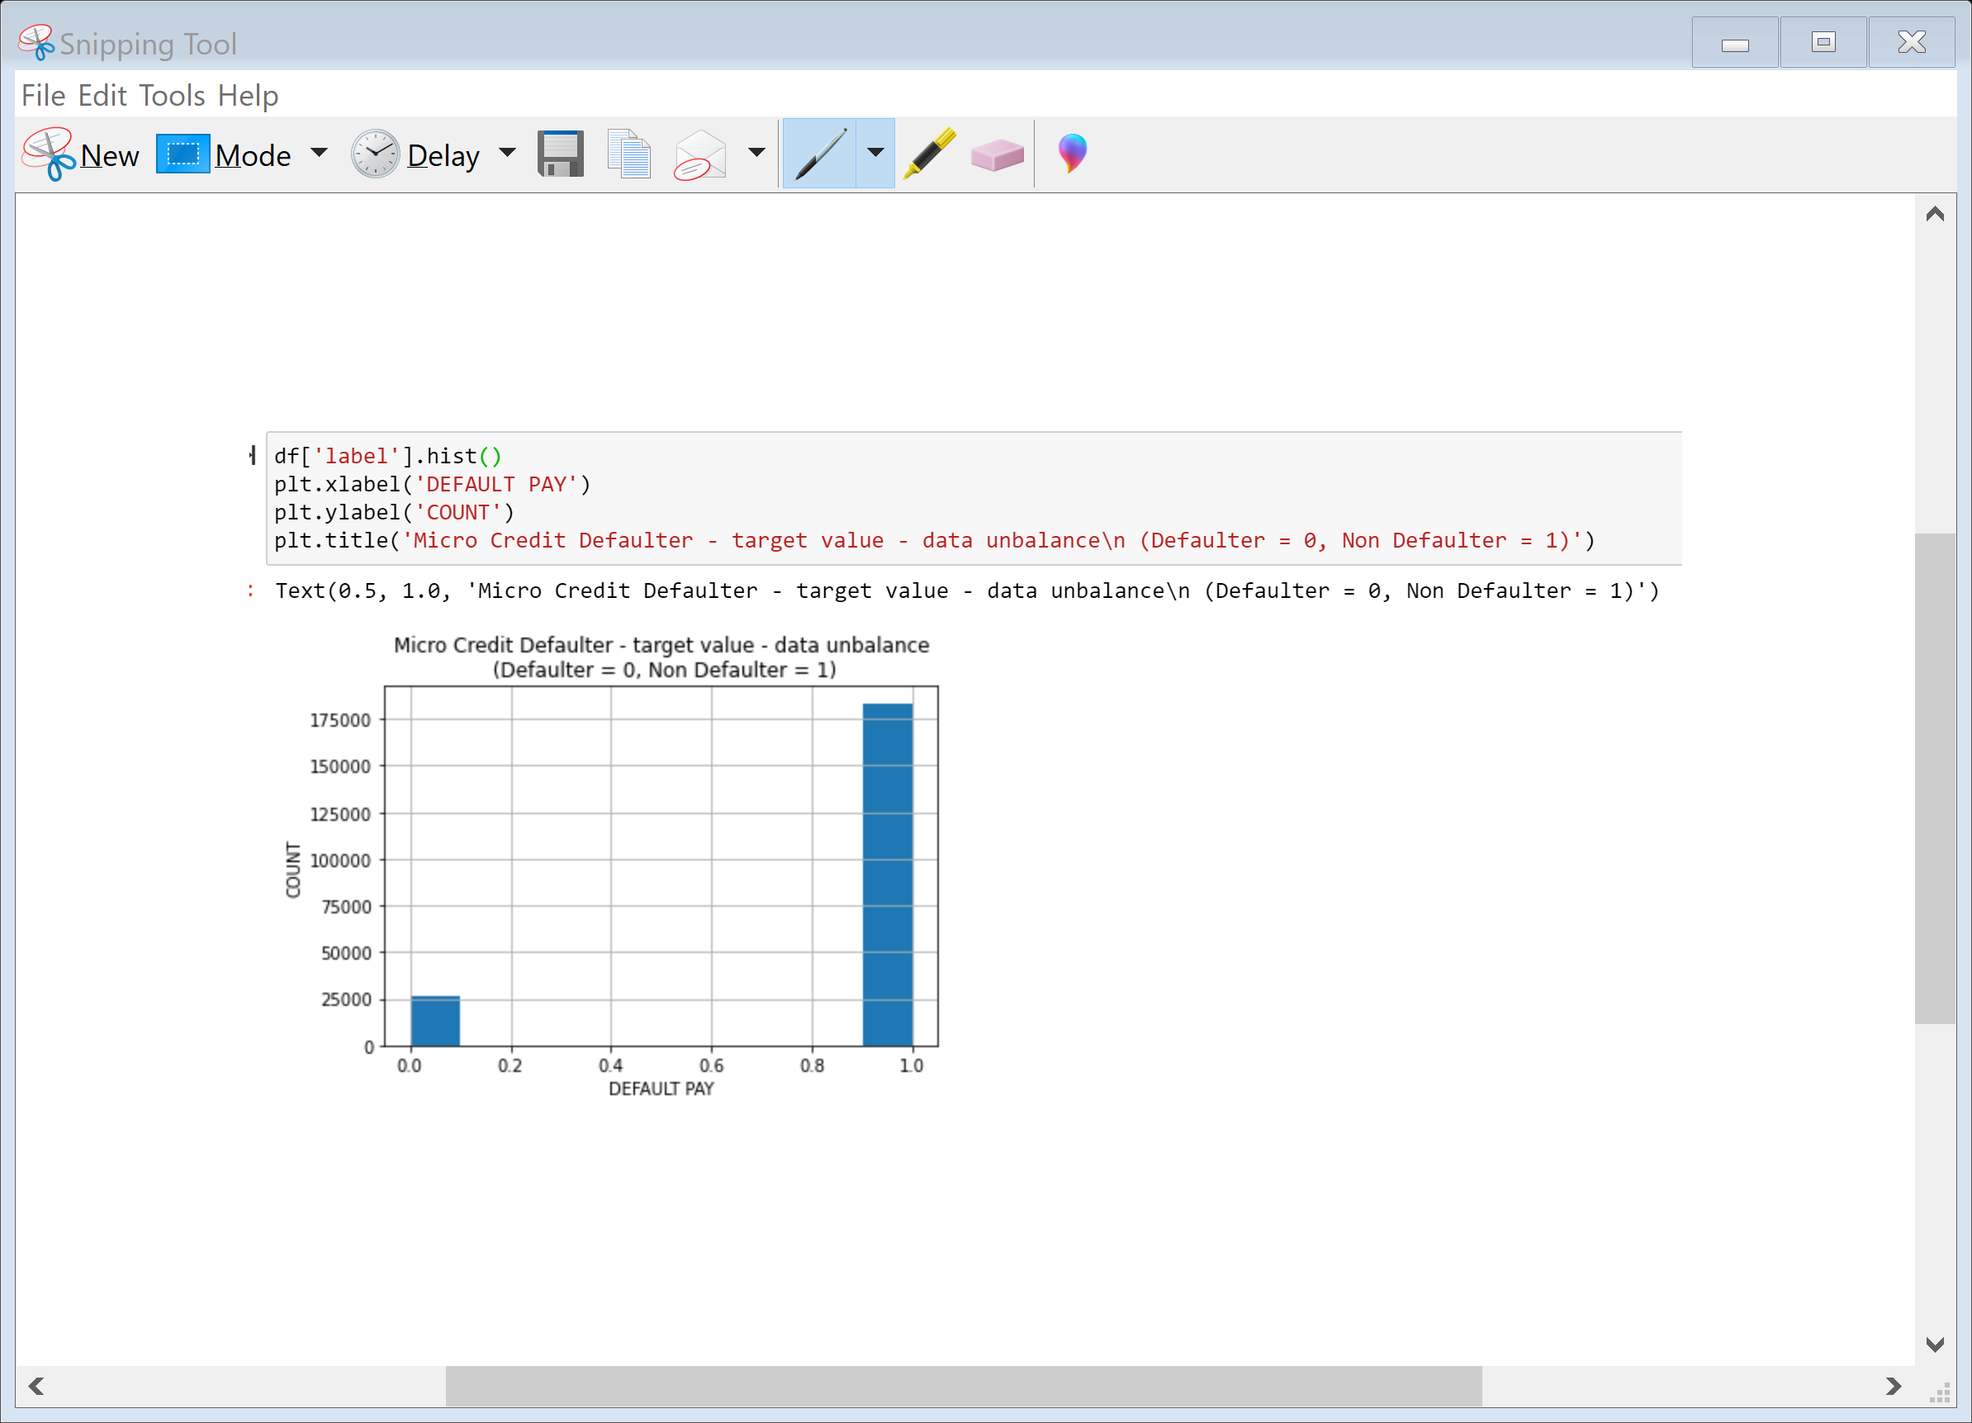
Data Visualization and Analysis
As we can see in observation the data set in unbalance. The Defaulters are very less as compared to non-Defaulters.

Slide 9
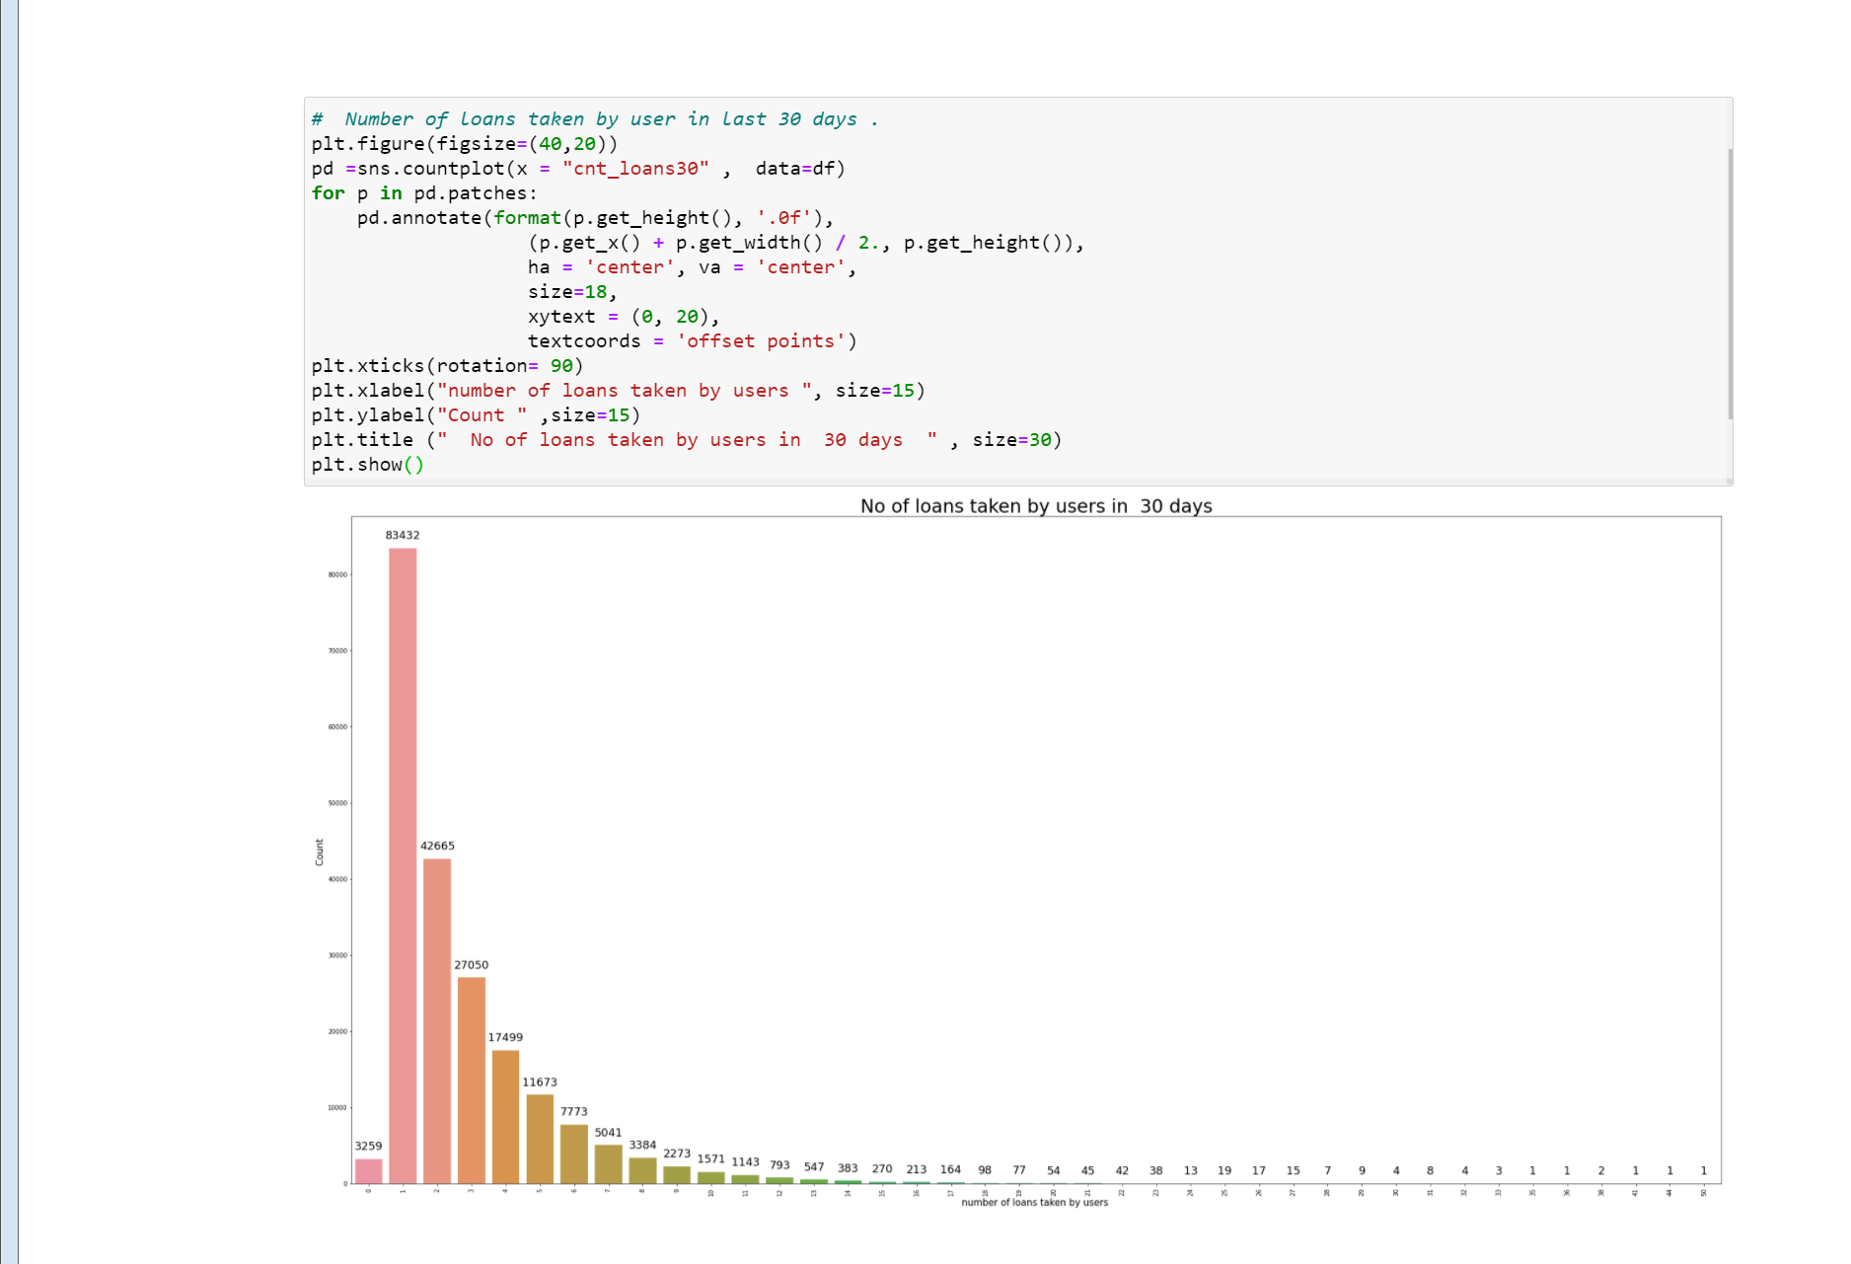
In the observation we can see that majority of the users have taken 1 loan in 30 days

Slide 10
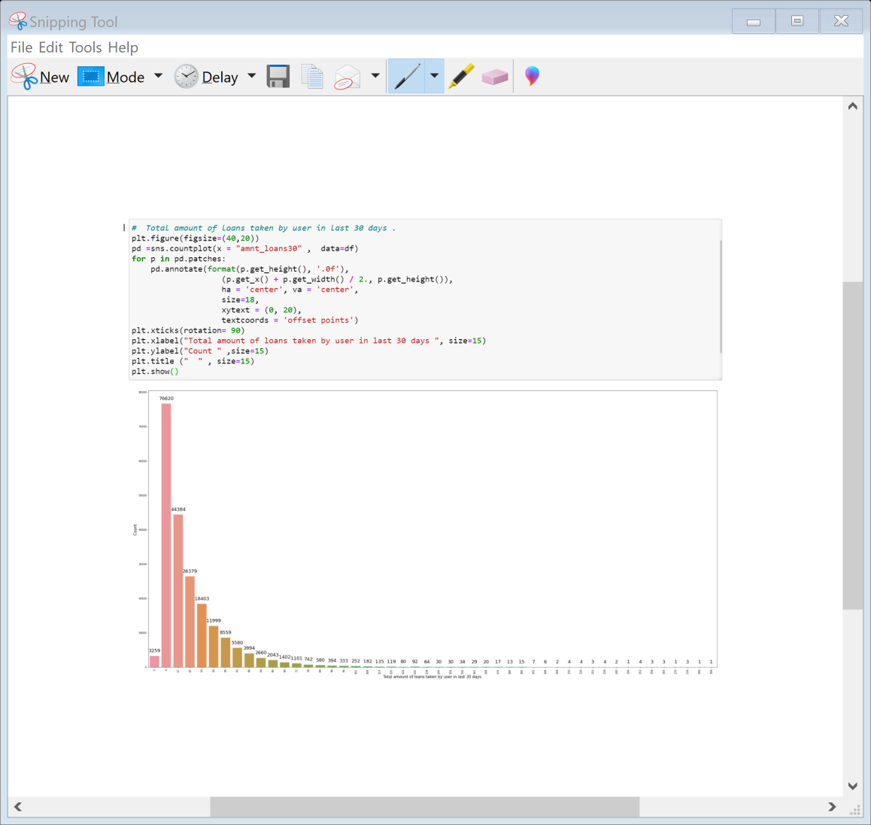
In the observation we can see that most of the users have taken 6 (Indonesian rupiah) to 30 (Indonesian rupiah) loans. Only Few users have taken loan of more than 30 (Indonesian rupiah)

Slide 11
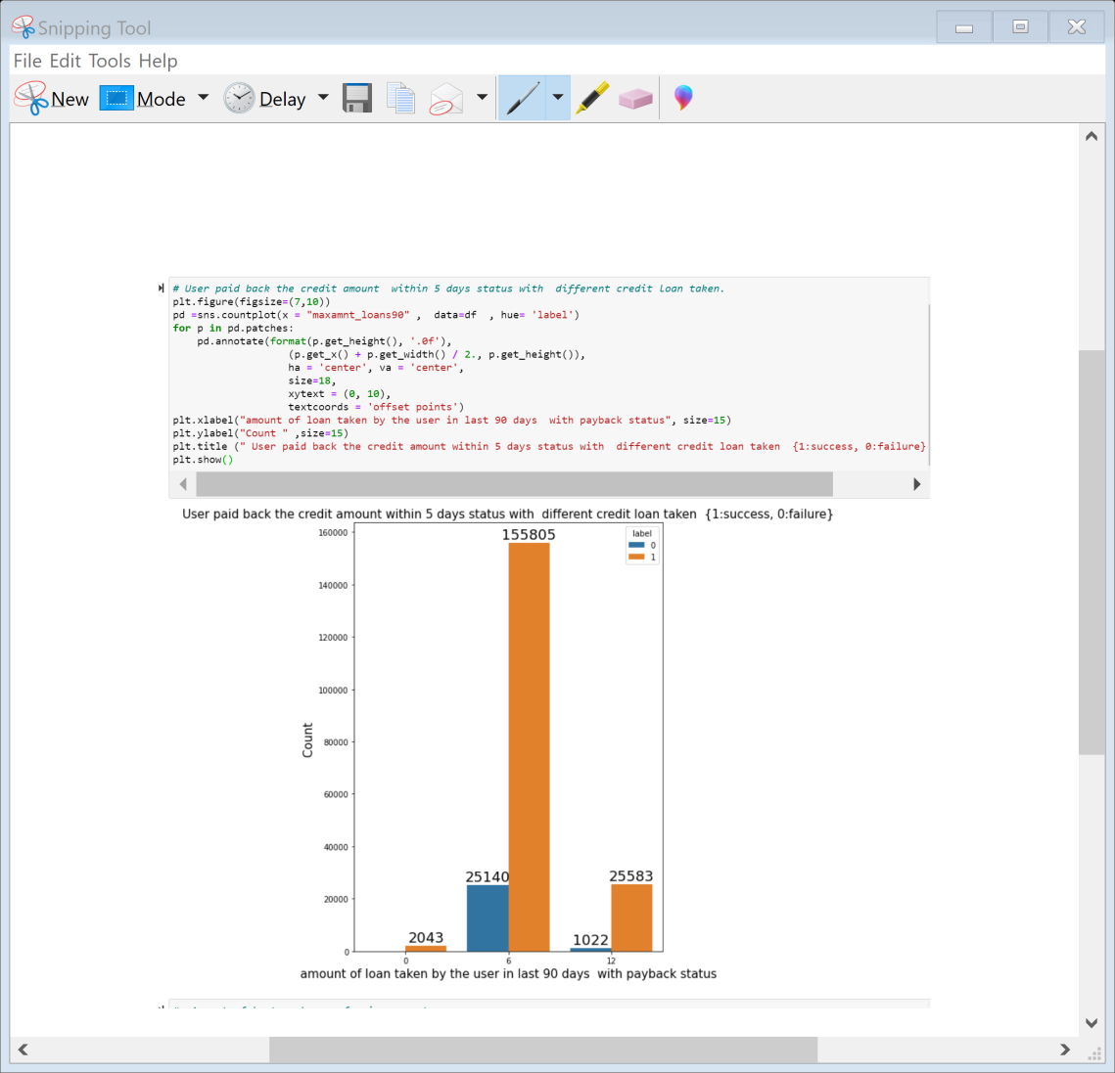
As we can see majority of users have paid back their loan of 6 (Indonesian Rupiah) and 12(Indonesian rupiah) within 5 days of time

Slide 12
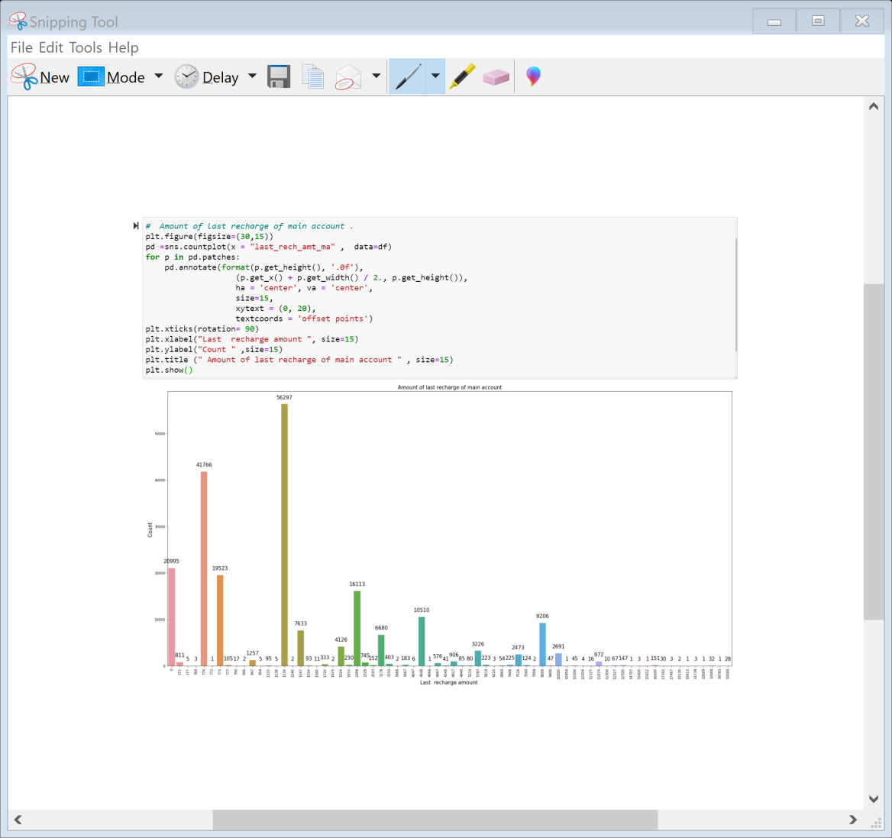
As we can see majority of people have recharge their main account with 770 and 1539 , very few users have have recharged their main account with more than 10,000 rupee

Slide 13
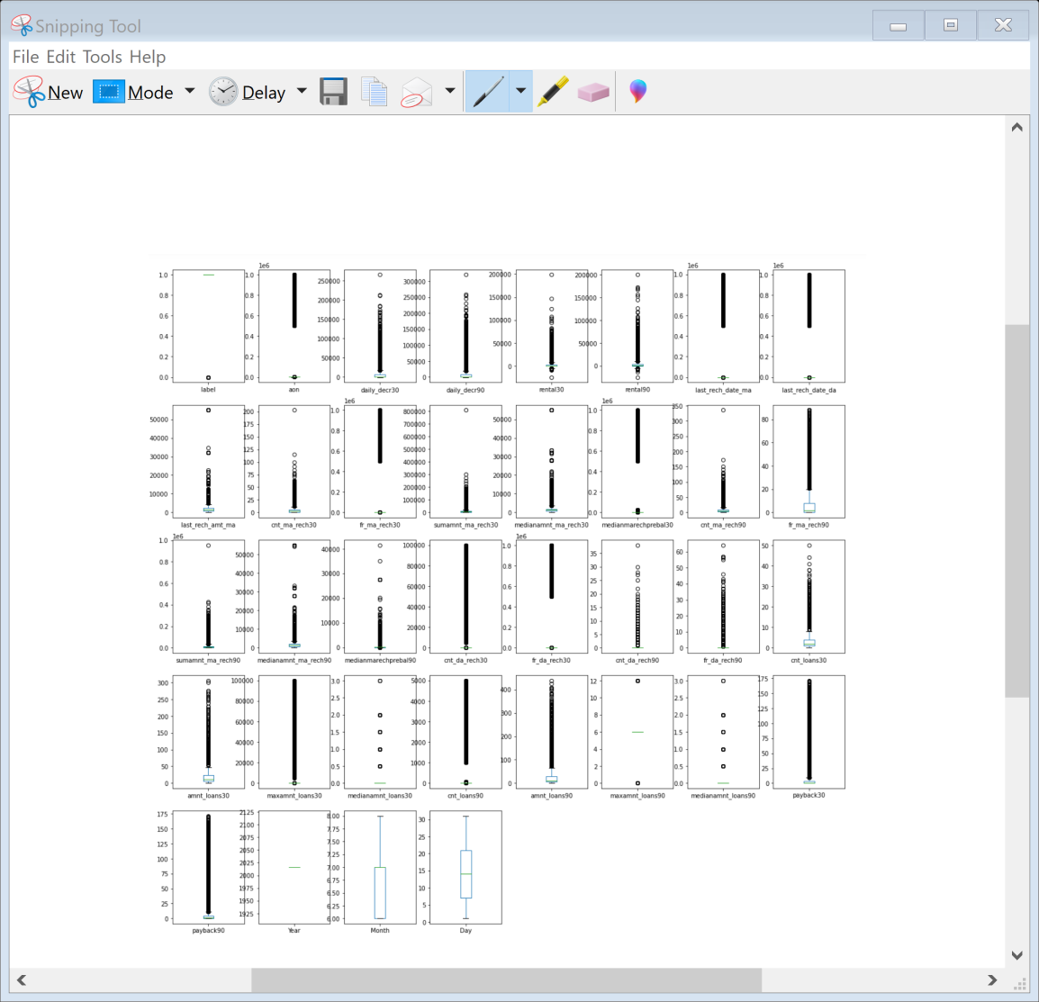
We can see that many outliers are present in the dataset. Further we will try to Reduce Outliers in the dataset

Slide 14
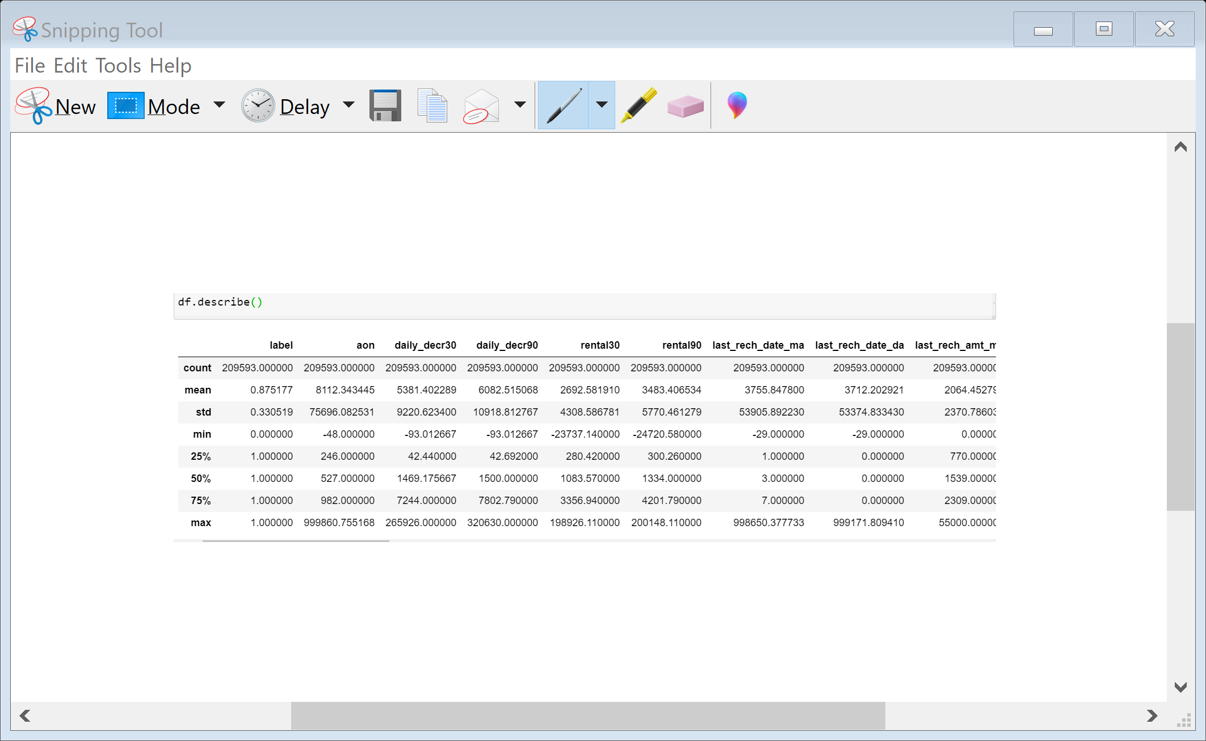
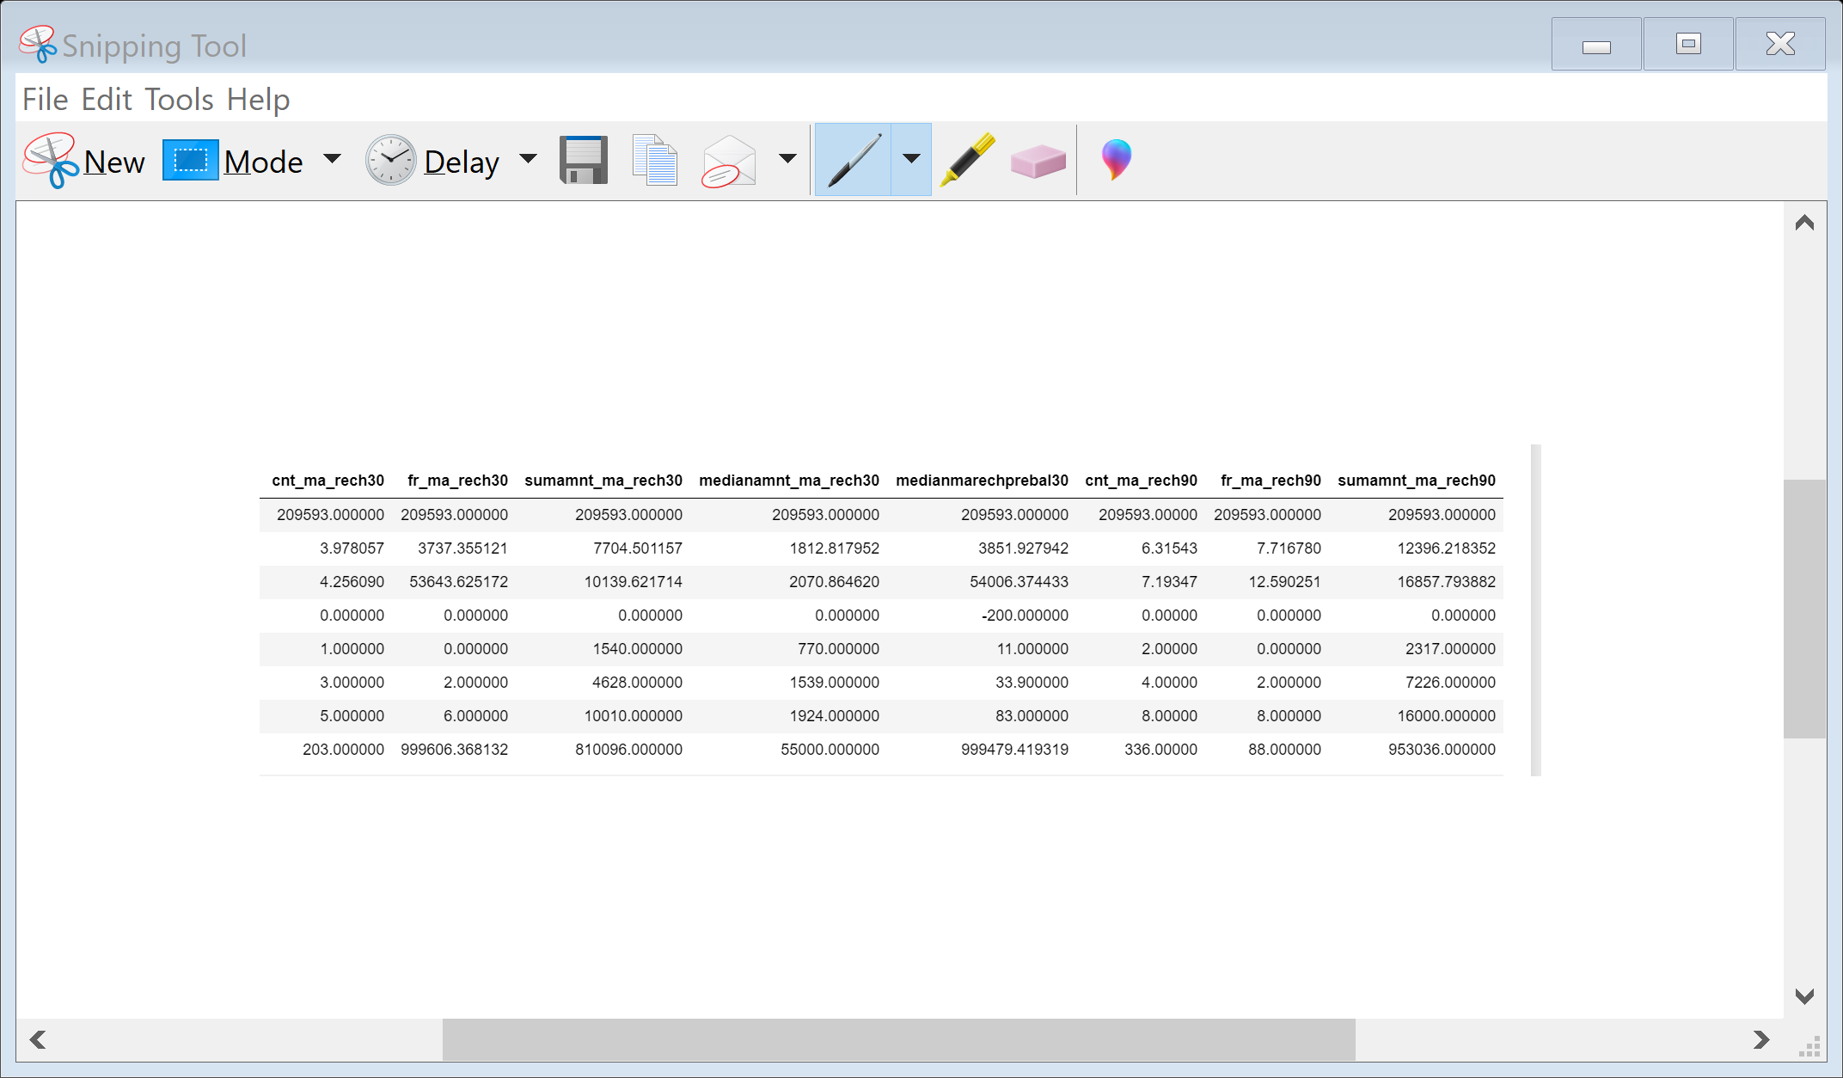
Statistical Analysis
There are 209593 distinct micro-credit customers.
The average value for Number of days till last recharge of main account is 3755.84. The standard deviation is unusually large, max value being 998650.37.
The average value for Number of days till last recharge of data account is 3712.20. The standard deviation is unusually large, max value being 999171.80.
The average value for Number of times main account got recharge in last 30 days is 3.97 and the max value of recharge is 203.
The average value for number of times data account got recharge in last 30 days is 262.57. The standard deviation is high , amx value being 99914.44
The average value for number of loans taken by user in last 30 days is 2.75 and std is 2.55 , max value is 50.

Slide 15
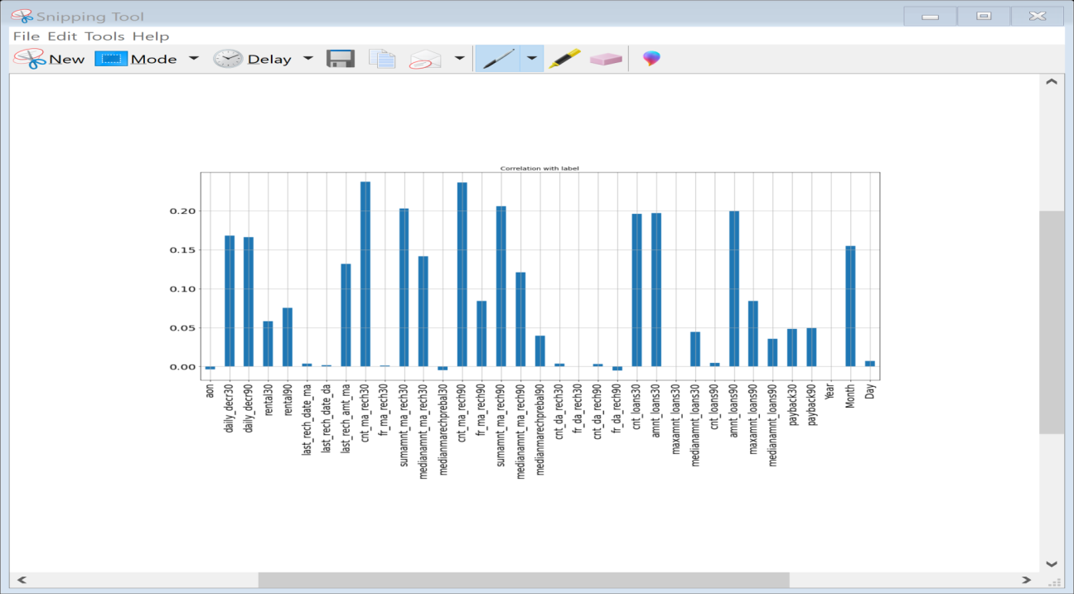
Co-relation with Target Variable Label
It seems from the above graph is that negatively correlated feature is age on cellular network in days, medianmarechprebal30, but we cannot blindly remove this feature because according to me it is very important feature for prediction. msisdn, year, pcircle and Frequency of data account recharged in last 30 days is unimportant and it has no role in prediction so we will remove it later.

Slide 16
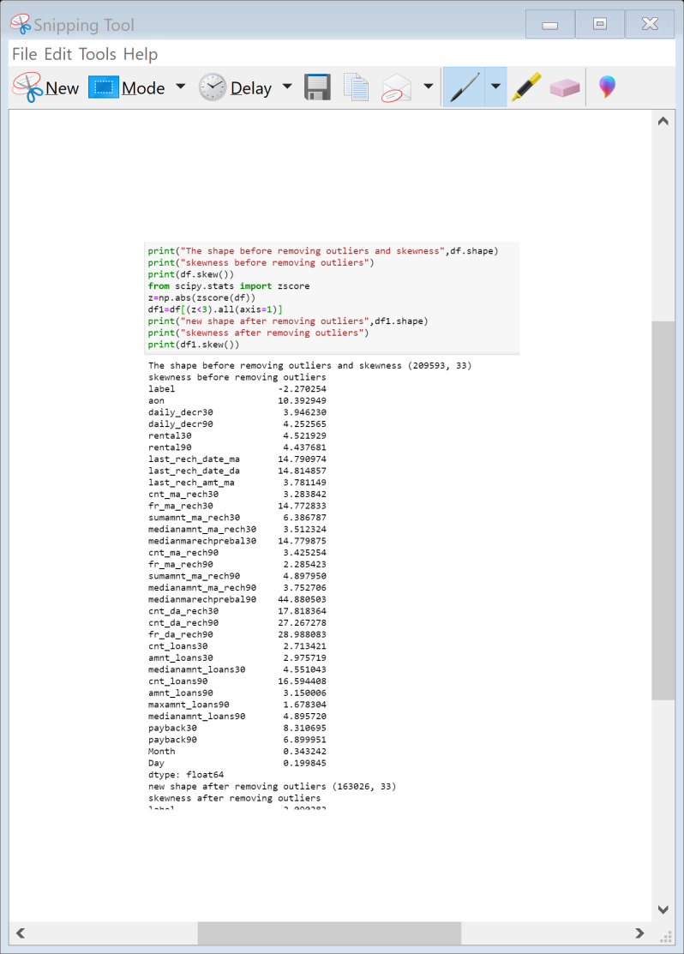
Lets Remove outliers from the Data set and check the new shape of data set

Slide 17
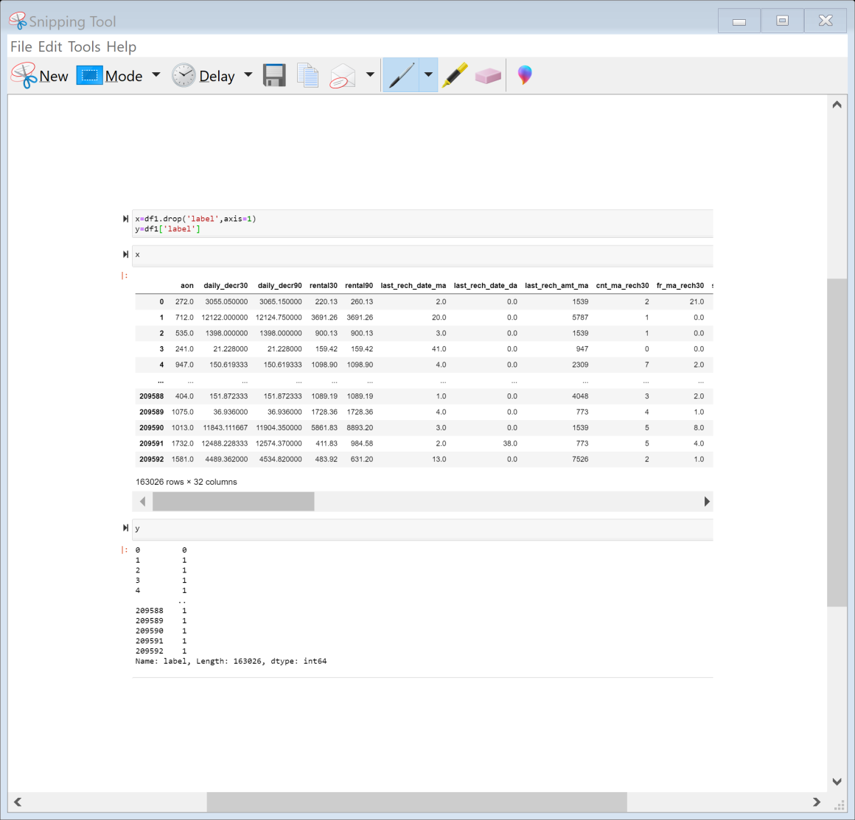
Spliting Data into Input and Output Variable

Slide 18
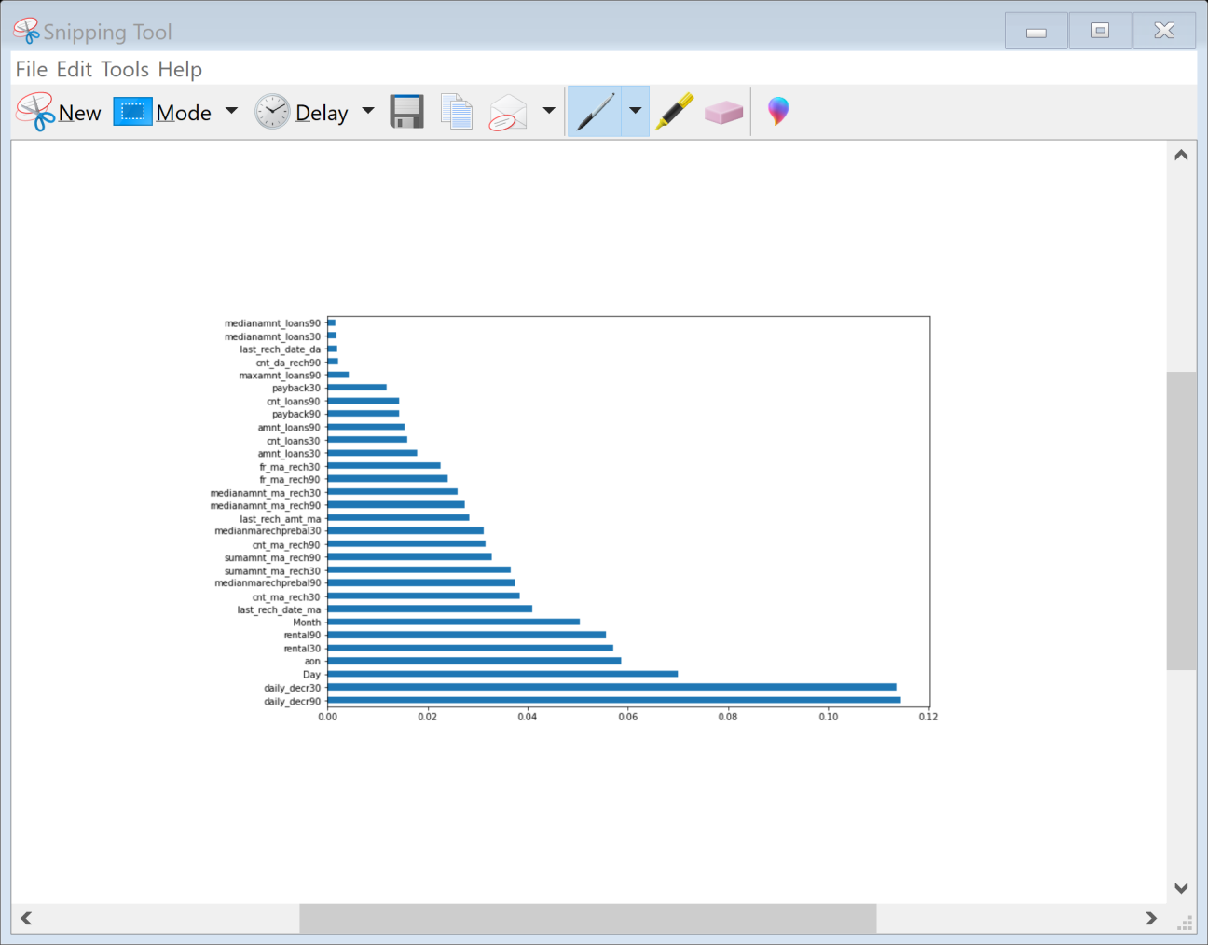
Checking Feature Importance
You can get the feature importance of each feature of your dataset by using the feature importance property of the model.
Feature importance gives you a score for each feature of your data, the higher the score more important or relevant is the feature towards your output variable.
Feature importance is an inbuilt class that comes with Tree Based Classifiers, we will be using Extra Tree Classifier for extracting the top 10 features for the dataset

Slide 19
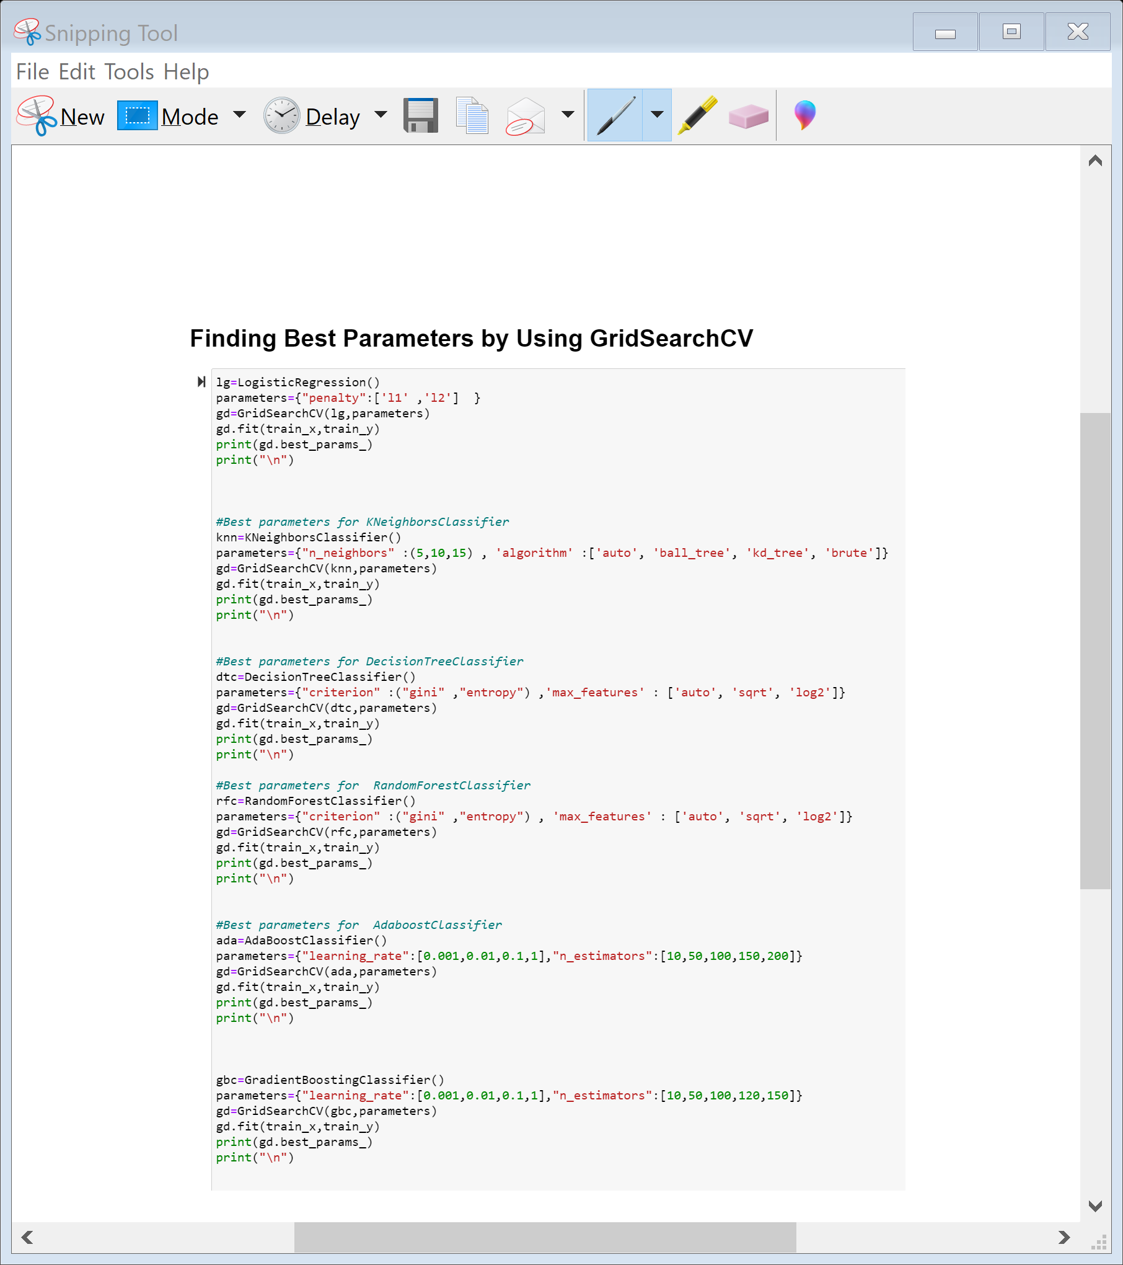
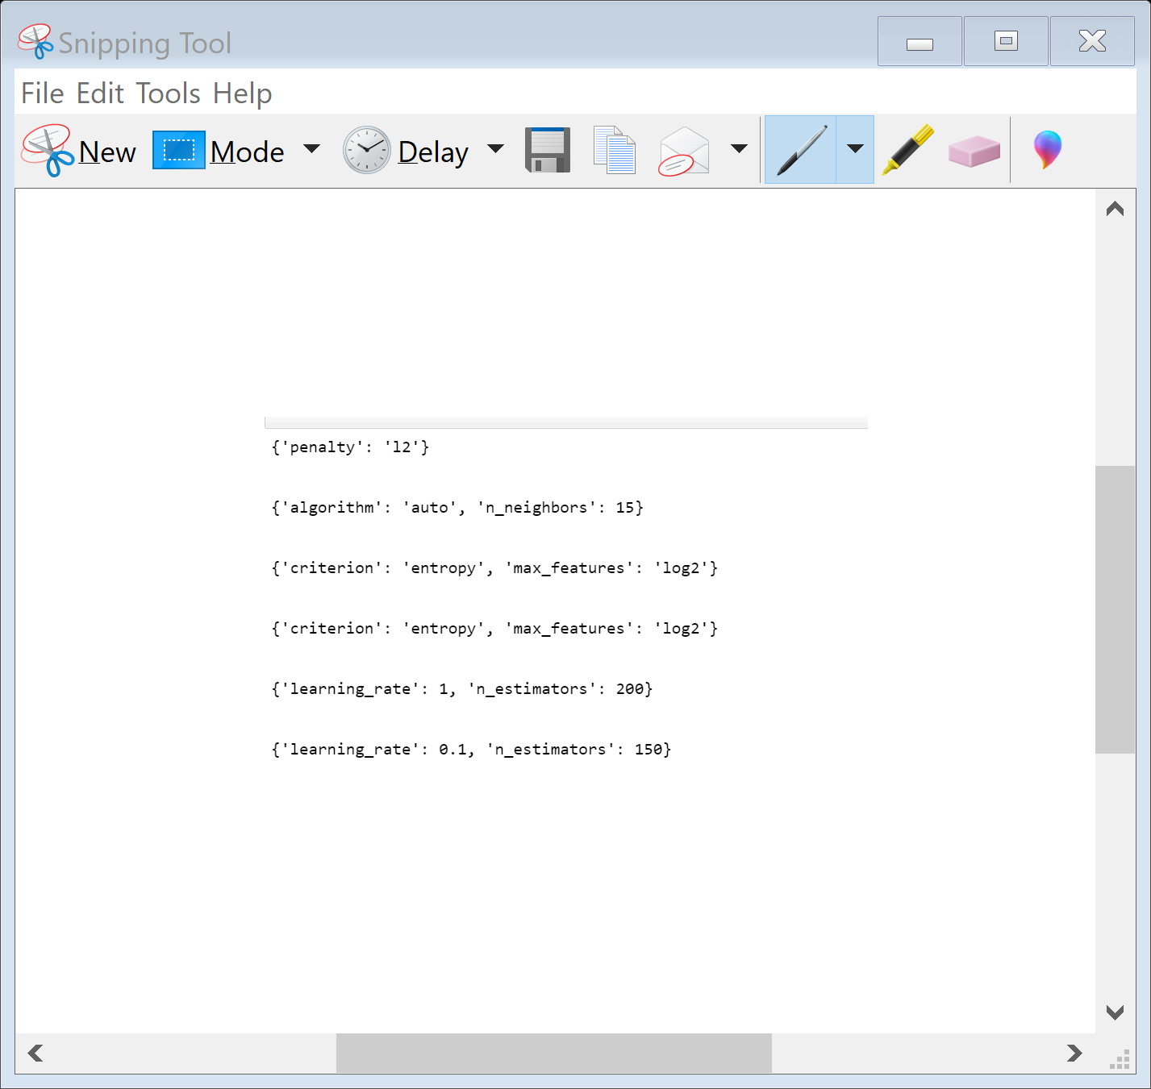
Finding Best Parameters By Using Grid Search CV

Slide 20
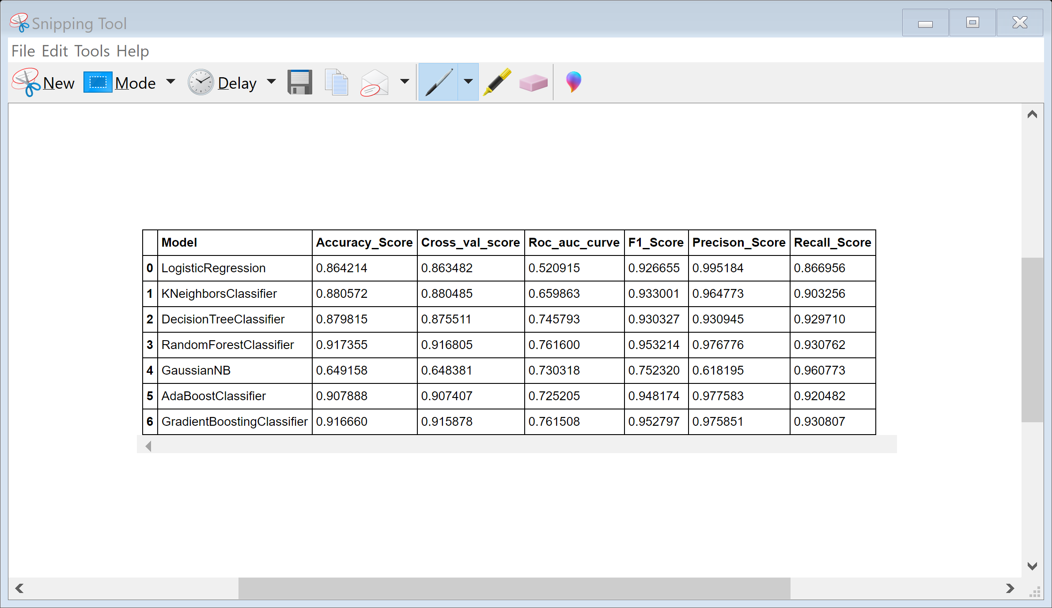
Lets see the results after finding best parameter and applying grid search cv on different models

Slide 21
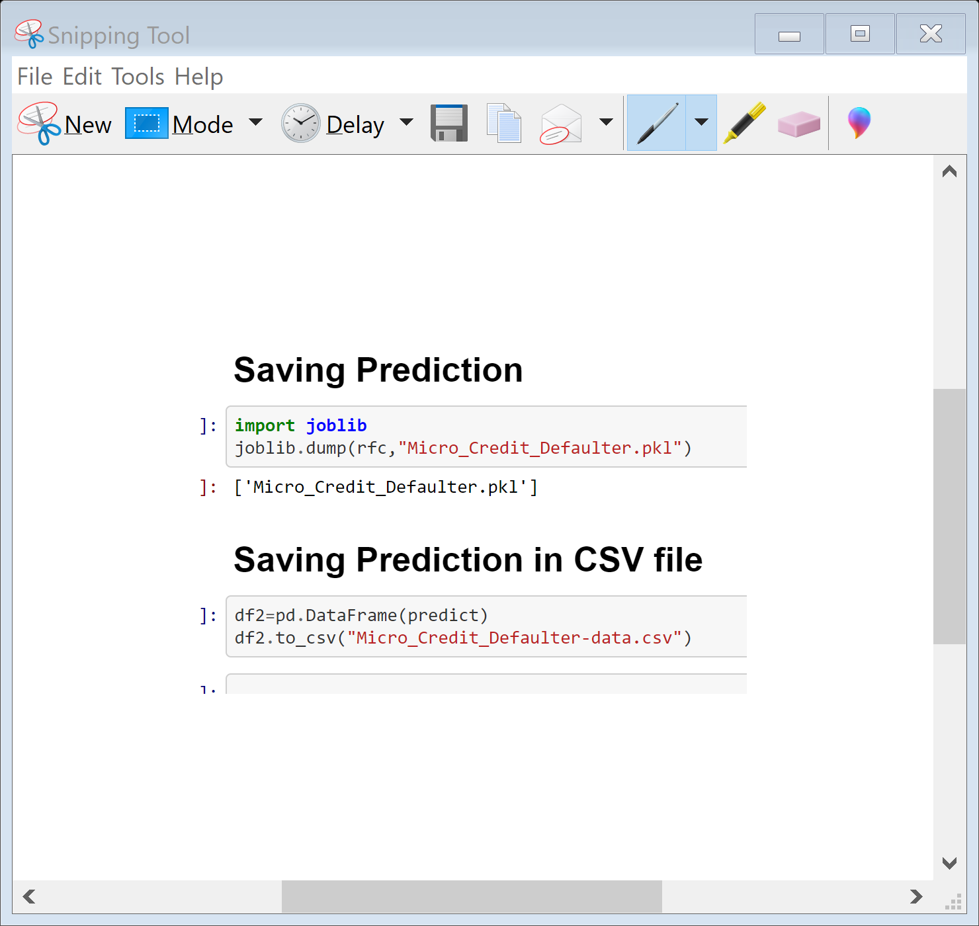
Saving the model

Slide 22
Conclusion
Today, microfinance is widely accepted as a poverty-reduction tool, representing $70 billion in outstanding loans and a global outreach of 200 million clients.
The aim was to determine an appropriate quantative model for using financial information pertaining to the loan and customer behaviour on the mobile network to predict the outcome of the loan. Classification models are appropriate for dealing with the two distinct outcomes for customer behaviour of repayment nd deafaulter.
We have used different models for the prediction.
1)Using a Logistic Regression classifier, we can predict with 86.57% accuracy,
2)Using Gradient Boosting classifier, we can predict with 91.72% accuracy
3)Using a Randon Forest classifier, we can predict with 91.78% accuracy,
4)Using a K-Nearest Neighbour classifier, we can predict with 87.54% accuracy,.
5)Using a Decision Tree classifier, we can predict with 87.90% accuracy,
6) Using Gaussian NB we can predict with 65.54 % accuracy
7) Using Ada Boost Classifier we can predict with 90.73% accuracy

